Slide 1

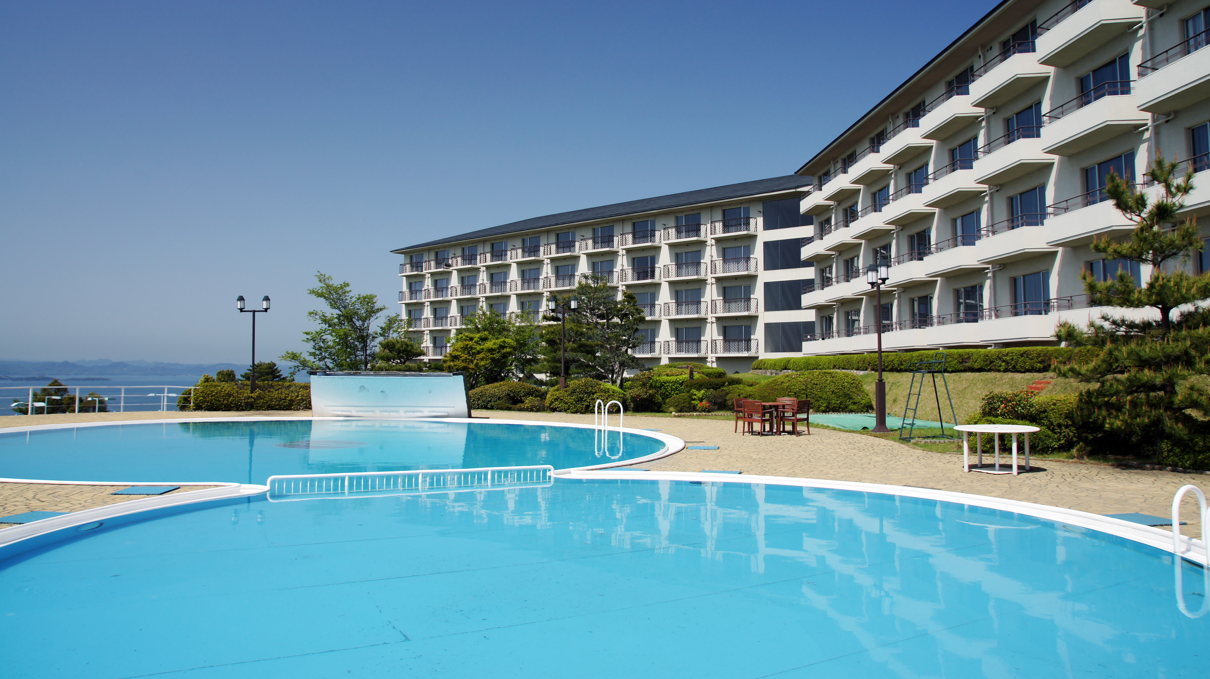
HOTEL RESERVATION ANALYSIS
TALAL MANSHOOR
Batch – MIP-DA-10

Slide 2

Problem Statement
Tourism is one of constantly growing and highly profitable industry. Thus hotels are more keen about their customers, their services, and their value in industry. The problem statement is to retrieve insights from the dataset provided by hotel and help them in making data driven decisions yielding more better customer experience and profit.

Slide 3
Dataset
Guest Information | Reservation Details | Booking Context
Booking_ID: Unique identifier for each reservation. | no_of_weekend_nights: Number of nights booked on weekends. no_of_week_nights: Number of nights booked on weekdays. | market_segment_type: Category of customer the reservation belongs to.
no_of_adults: Number of adults in the reservation. | arrival_date: Date the guests are scheduled to arrive. | avg_price_per_room: Average price per room for the reservation.
no_of_children: Number of children in the reservation. | type_of_meal_plan: Meal plan chosen by the guests | booking_status: Current status of the reservation
 | room_type_reserved: The type of room reserved by the guests.
Dataset contains following columns which are represented in group form for better understanding

Slide 4
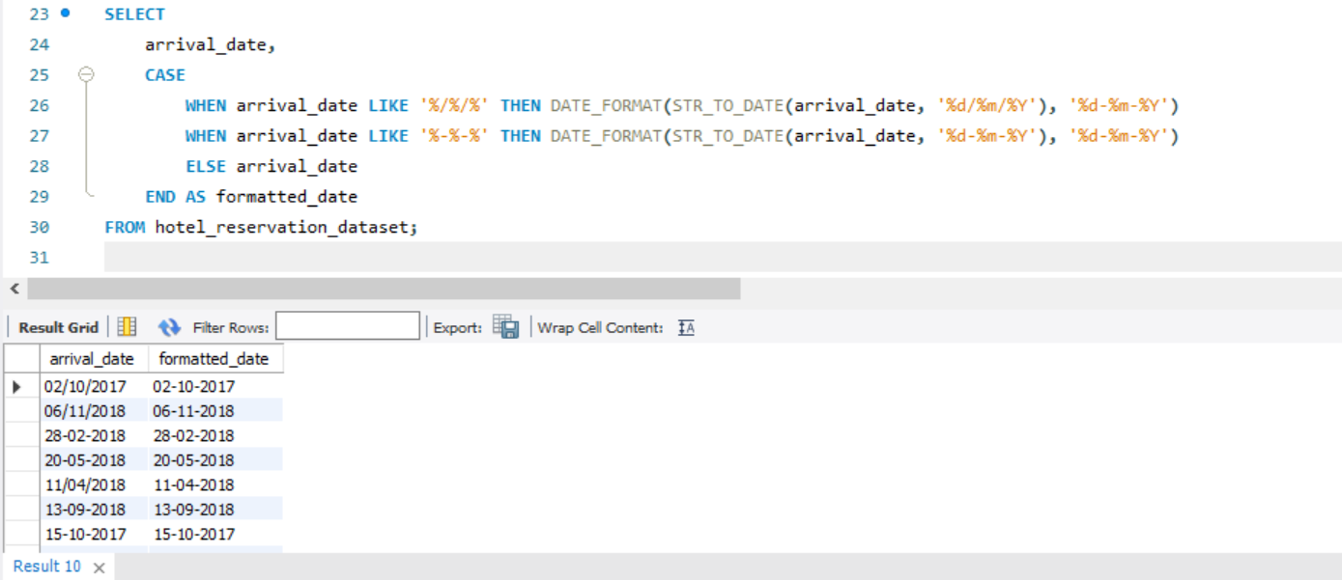
Arrival_Date column Inconsistency
Arrival_date had date in two different formats in string data type which is first changed to same format string then changed data type to date

Slide 5
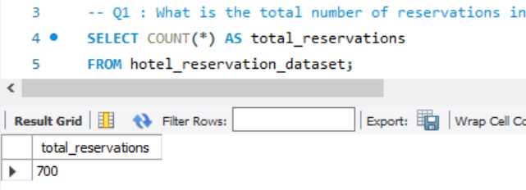
What is the total number of reservations in the dataset?

Slide 6
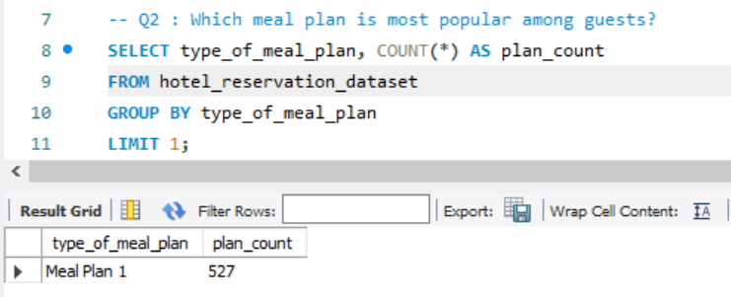
Which meal plan is the most popular among guests?

Slide 7
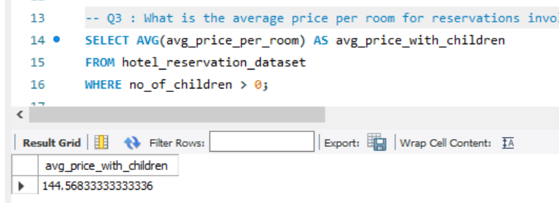
What is the average price per room for reservations involving children?

Slide 8
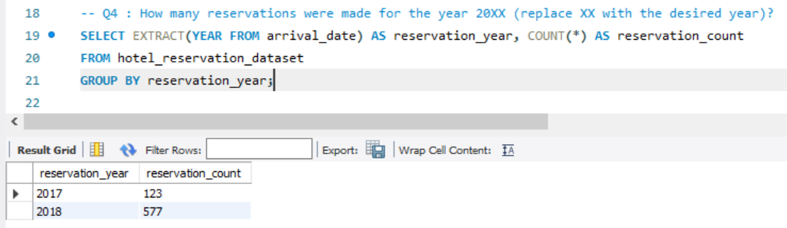
How many reservations were made for the year 20XX?

Slide 9
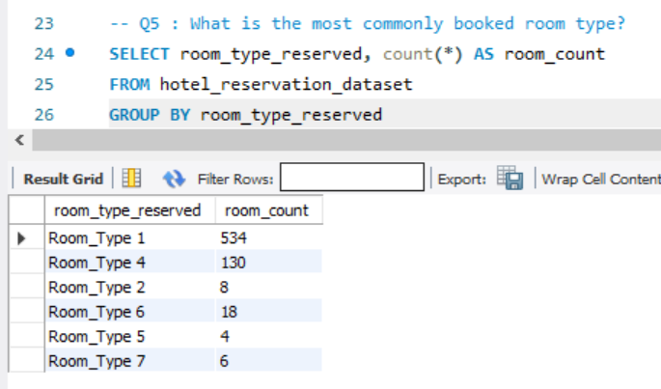
What is the most commonly booked room type?

Slide 10
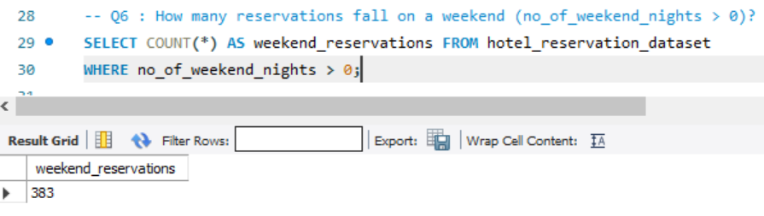
How many reservations fall on a weekend?

Slide 11
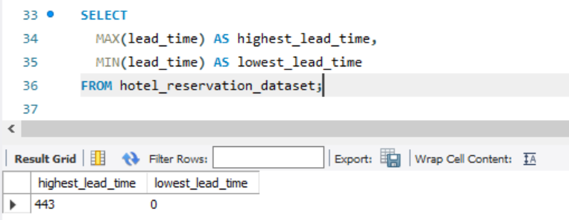
What is the highest and lowest lead time for reservations?

Slide 12
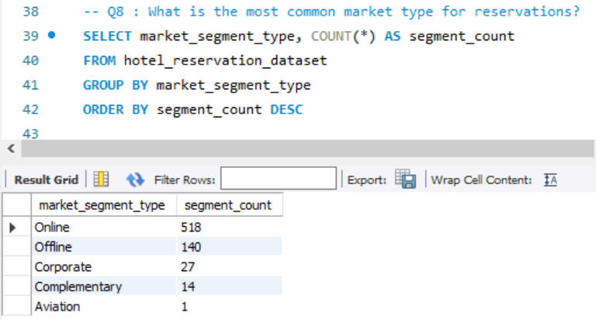
What is the most common market segment type for reservations?

Slide 13
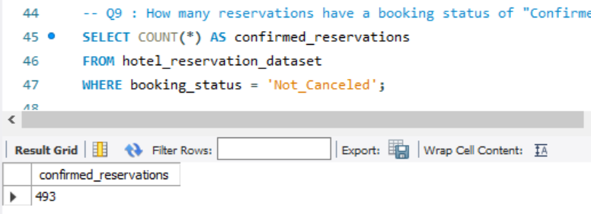
How many reservations have a booking status of "Confirmed"?

Slide 14
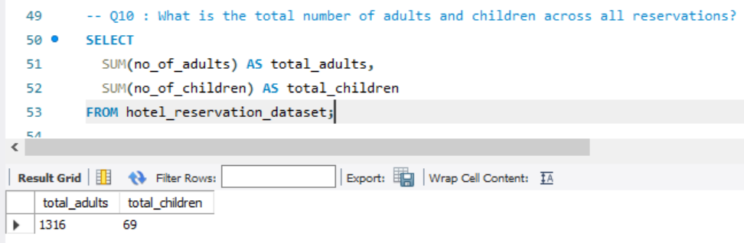
What is the total number of adults and children across all reservations?

Slide 15
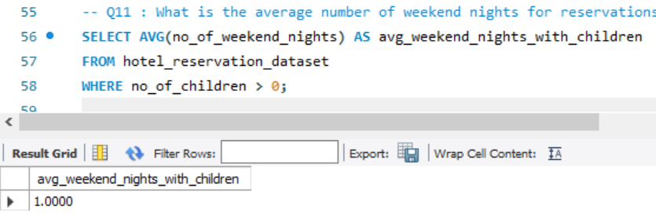
What is the average number of weekend nights for reservations involving children?

Slide 16
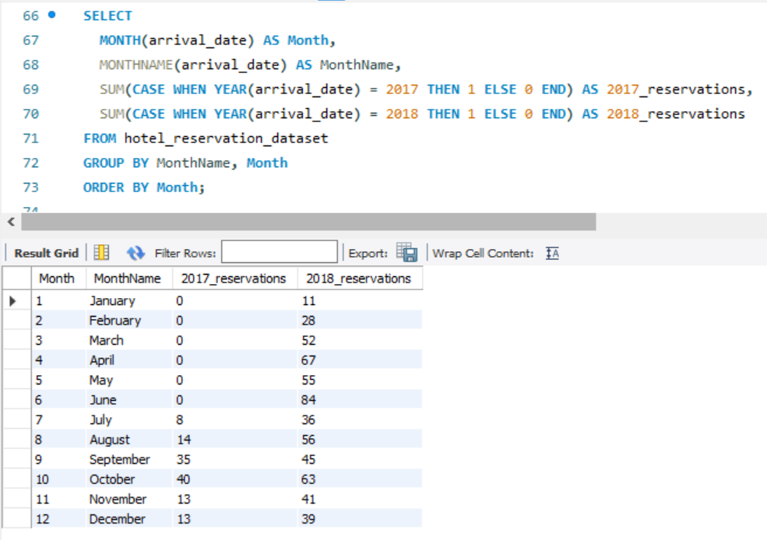
How many reservations were made in each month of the year?

Slide 17
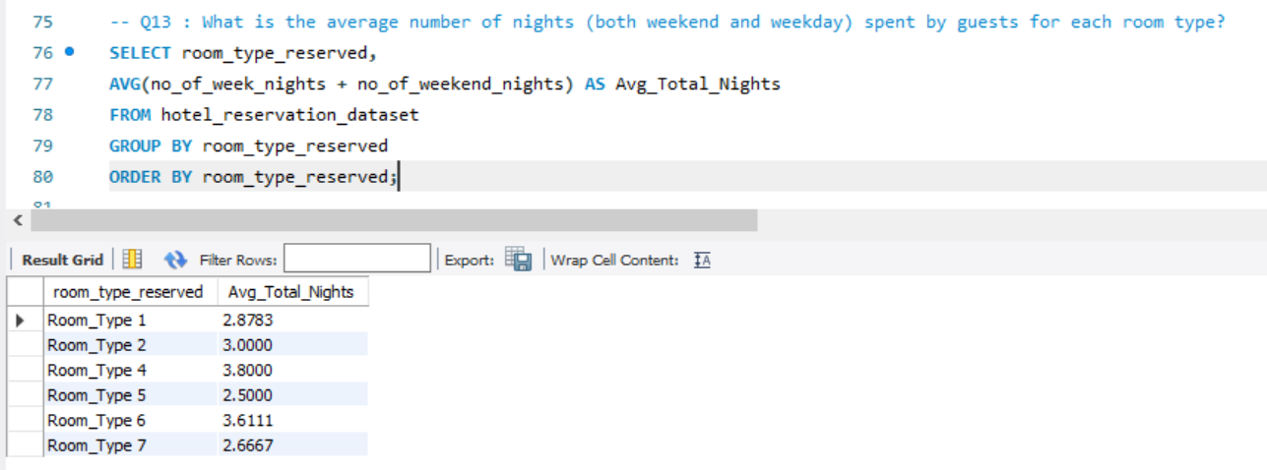
What is the average number of nights spent by guests for each room type?

Slide 18
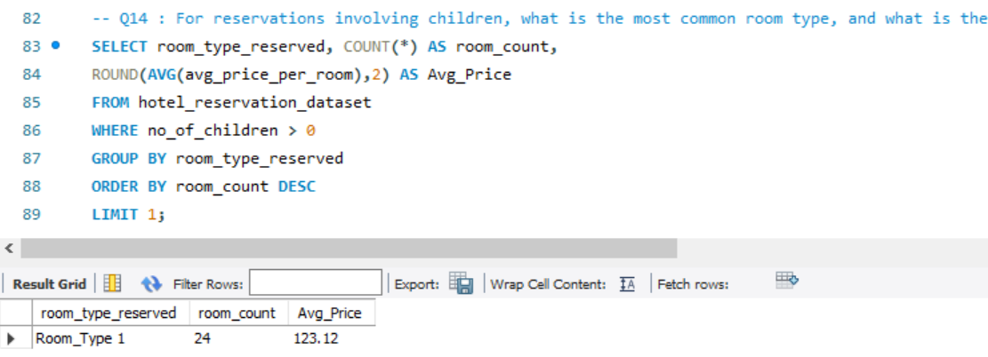
For reservations involving children, what is the most common room type, and what is the average price for that room type?

Slide 19
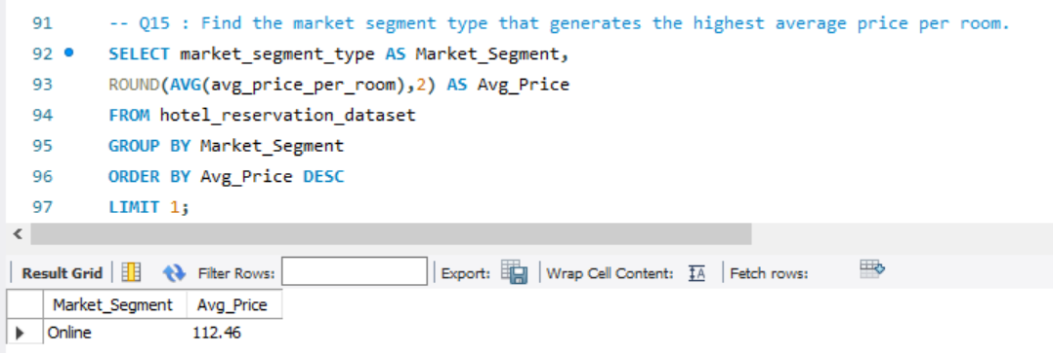
Find the market segment type that generates the highest average price per room.

Slide 20
CONCLUSION
ALL THE QUESTIONS ASKED BY HOTEL MANAGEMENT ARE ANSWERED USING SQL QUERY AND PROVIDED TO STAKE HOLDERS FOR IMPROVEMENTS IN BUSINESS PROCESS

